Slide 1
Internet Users Effect on Depression
Darshan Patil

Slide 2
Background
Due to the cyber bullying, harassment, and financial exploitation in modern day society, humans have been showing more signs of depression as each day goes on.
I then wondered if this issue is as prevalent among other areas of the world and specifically 3rd world countries with lower access of internet.

Slide 3
According to the NCBI there has been an almost 8% increase in report cases of depression just between 2015 and 2020 which further intrigued me to investigate.

Slide 4
Hypothesis
With these numbers on a rapid rise, how can an individual mitigate their risk of depressive disorder.
Should they move to a different country where internet access is less prevalent among citizens?

Slide 5
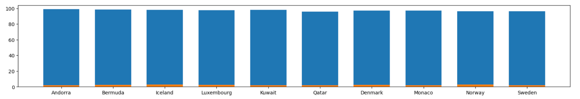
The 10 countries below are among the countries with the highest number of Internet Users.
With the percentage of people with depressive disorder being in orange we can see that it is not a significant portion of the total users on the internet in these countries.

Slide 6
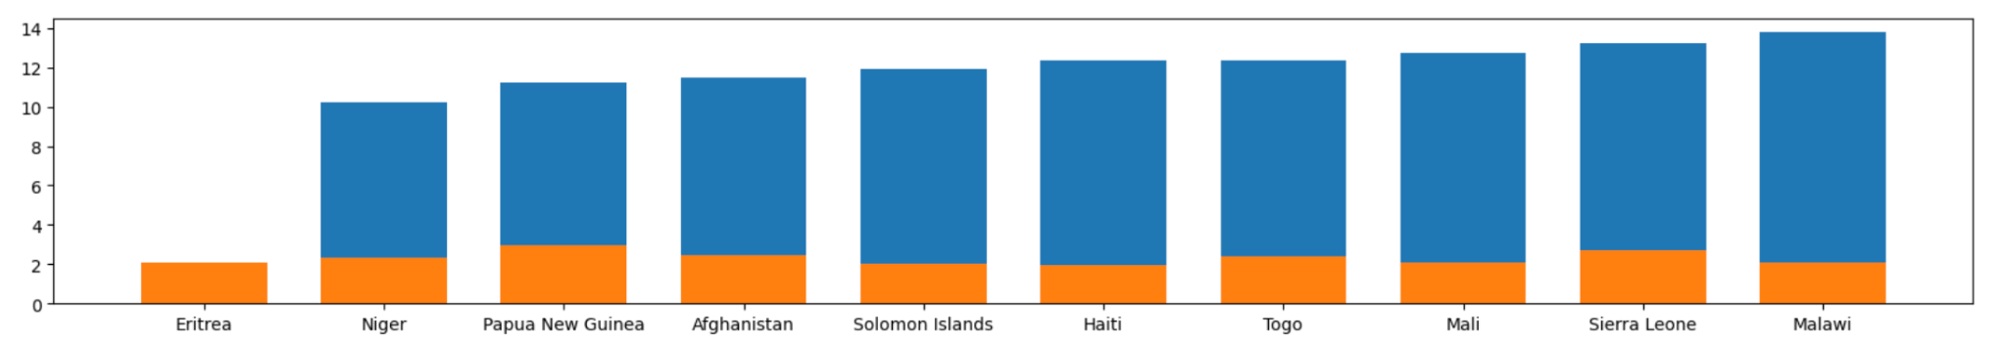
The 10 countries below are among the countries with the lowest number of Internet Users.
Although the users on internet are very low among these countries, we can still observe that with lower internet access civilians still exhibit a high amount of depressive disorder cases compared to the number of people using the internet.

Slide 7
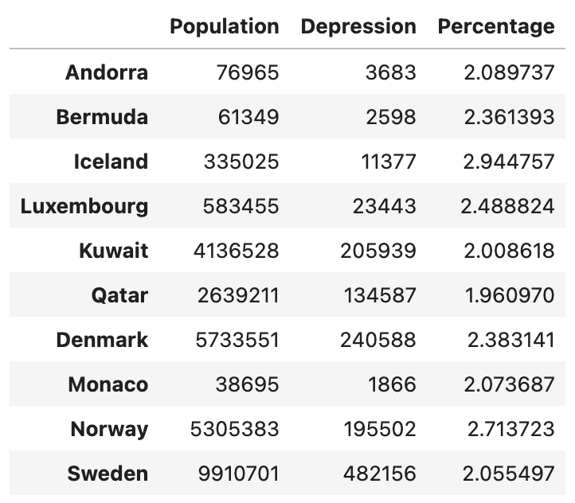
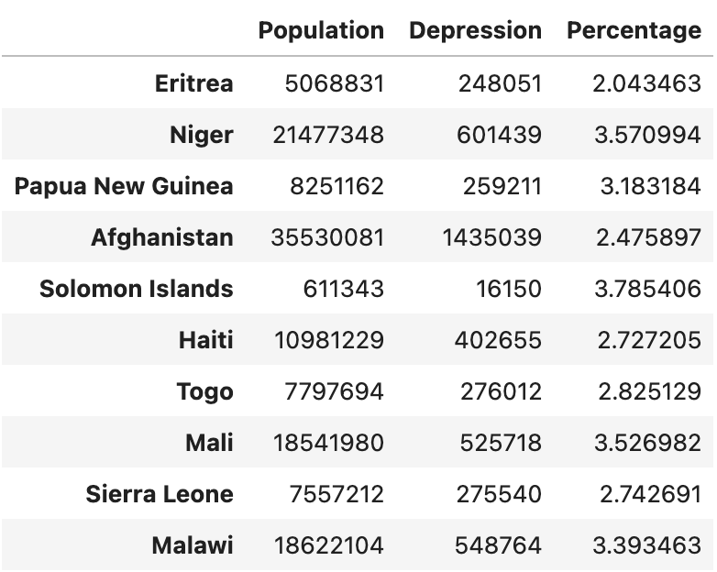
Data Charts
After cleaning the data, I created a new dataframe where I have found the Percentage between each of these 10 countries by dividing the population from one of my datasets with the number of depressive disorder cases from another dataset.

Slide 8
Countries with
High Internet Users
Low Internet Users
2.308%
3.027%
This average percentage of depression. It is calculated by dividing the population and number of residents with depressive disorders in each country, then taking the mean of those values to find the average percentage of depression among the set of chosen countries. This percentage is important because it shows us the 0.719% different between countries with low and high internet users. This helps proves that on average countries with high internet users on average have lower cases of depressive disorder.

Slide 9
81.3% vs 92.2%
The National Library of Medicine conducted a study to evaluate if those with mental health problems had less access to the internet than those without mental health problems.
After the study was conducted they concluded that “Access to the internet was poorer for those with mental health problems (87.8%) than those without mental health problems (92.2%), and the difference was greater when a measure of more severe mental health conditions was used (81.3% vs 92.2%)”(NCBI, 2020).

Slide 10
A study by the China Family Panel Studies investigated the effects of internet users. Due China's fast growing population they were able to test 7801 adults aged over 60 years old to find the relationship between mental health disorders and the internet.
The study concluded that elders who used the Internet showed lower signs of mental health and depressive symptoms. This is due to the fact that, “using the Internet for social contact and entertainment decreased the depression scores of the older adults, but when using Internet for learn, work, and commercial activity, the relief of depressive symptoms disappeared.”
This study also supports my analysis because countries with the lowest internet access have a higher level of depression possibly due to the inability to contact family and friends and lack of entertainment

Slide 11
Conclusion
Hypothesis:
The answer to my hypothesis is that individuals should not move to a country where internet is less prevalent among residents. This conclusion is primarily due to the difference in percent of depressive disorders between the top and bottom 10 countries with internet users.
The study by NCBI supports my conclusion as it shows that Internet usage among individuals with mental health disorder is lower than ones without. The second study helped prove that the reason that countries with higher internet have lower rates of depressive disorders is because users have entertainment, activities and higher levels connectivity for their social lives, which all help eliminate mental health problems.

Slide 12
Datasets used in code and analysis:
https://www.kaggle.com/datasets/tanuprabhu/list-of-countries-by-number-of-internet-users
https://ourworldindata.org/grapher/number-with-depression-by-country?tab=table
External Sources:
https://www.ncbi.nlm.nih.gov/pmc/articles/PMC9483000/
https://www.ncbi.nlm.nih.gov/pmc/articles/PMC7260658/
https://www.frontiersin.org/articles/10.3389/fpsyt.2021.739085/full

